Slide 1
ELURU COLLEGE OF
ENGINEERING AND TECHNOLOGY
SignNet-II:
(Approved by AICTE-NEW DELHI &
Affiliated to JNTU-Kakinada)
An End-to-End Transformer Architecture for Bidirectional Sign Language Translation
DEPARTMENT OF COMPUTER SCIENCE
AND ENGINEERING
ECET
Team Members
1. Tirumala Satya Sai Ram
22JD1A05B2
2. Veeravalli Manohar
22JD1A05B7
3. Kolusu Ganesh
22JD1A05C6
⚡ FINAL YEAR PROJECT · CSE
Team Guided by:
Ch. Sindhu Priyanka, B.Tech, M.Tech,(Ph.D)
Associate Professor
Eluru College of Engineering & Technology

Slide 2
ABSTRACT
Project overview — what was built, how, and what was achieved
SIGNNET II addresses the critical communication barrier between the Deaf and non- signers by replacing traditional, limited sequential models like RNNs and LSTMs with a high-performance Transformer-based architecture. While RNNs and LSTMs often struggle with long-range dependencies in complex gestures, SIGNNET II utilizes dual- stream input processing and advanced attention mechanisms to master the intricate spatial and temporal dynamics of sign language. This unified framework enables seamless bidirectional translation, converting sign-to-text and text-to-sign with superior accuracy, as evidenced by its state-of-the-art BLEU scores and recognition metrics. Engineered for the real world, the model supports real-time inference for live video conferencing and utilizes transfer learning to adapt across various global dialects. By integrating these technical advancements, SIGNNET II provides a scalable, inclusive solution that significantly outperforms previous sequential methods in both fluency and
robustness.
Eluru College of Engineering & Technology | Dept. of CSE | 2026

Slide 3
INTRODUCTION
Background and motivation for SignNet-II
Introduction
SIGNNET II addresses the limitations of traditional sequential models, such as Recurrent Neural Networks (RNNs) and Long Short-Term Memory (LSTM) networks, which often struggle to capture the complex spatial-temporal dependencies of sign language. By shifting to a Transformer-based framework, the model leverages self-attention mechanisms and a dual-stream input system to effectively process multimodal features like hand gestures and facial expressions. This architecture enables a unified, two-way translation (sign-to-text and text-to-sign), ensuring contextual fluency and superior accuracy compared to one-way, handcrafted legacy systems. Evaluated on large-scale benchmarks, SIGNNET II demonstrates high robustness and scalability, outperforming state-of-the-art methods in BLEU scores and recognition metrics. Furthermore, the model is optimized for real-time inference, making it a practical tool for live video conferencing and assistive technologies. Ultimately, SIGNNET II offers an extensible and inclusive solution, setting a new foundation for accessible communication between signers and non-signers globally.
Eluru College of Engineering & Technology | Dept. of CSE | 2026

Slide 4
OBJECTIVE
Primary goals of the SignNet-II translation system
The primary objective is to develop an End-to-End Transformer-based Sign Language Translation system that accurately performs bidirectional translation and provides seamless real-time communication for the Deaf community.
1
Bidirectional Translation
4
Real-Time Inference
Develop a unified framework capable of translating both sign-to-text and text-to-sign, overcoming the limitation of one-way systems.
Optimize the model for low-latency inference to enable live video conferencing, webcam-based recognition, and mobile assistive device deployment.
2
Transformer-Based Architecture
5
Robustness & Scalability
Implement a high-performance Transformer model with dual-stream input processing and advanced self-attention mechanisms for superior accuracy.
Utilize transfer learning and data augmentation to ensure high robustness across diverse signers, regional dialects, and real-world noisy environments.
3
Multi-Modal Feature Fusion
Simultaneously process video frames, hand keypoints, and facial expressions using a multi-modal fusion strategy to capture the full linguistic nuance of gestures.
Eluru College of Engineering & Technology | Dept. of CSE | 2026

Slide 5
SCOPE
Boundaries and coverage of the SignNet-II project
✔ IN SCOPE
✘ OUT OF SCOPE
Dataset Scope
Mobile App Deployment
CIC-IDS2017 equivalent: sign language video datasets balanced across multiple gesture classes including continuous and isolated sign sequences.
Native iOS/Android deployment is not included in this version. Future work may address mobile and edge-device optimization.
Translation Scope
Multi-Language Support
Bidirectional translation — sign-to-text (video/webcam input → text output) and text-to-sign (text input → sign animation output).
This version focuses on a single sign language dialect. Multi-language and regional sign dialect support is planned for future iterations.
XAI Integration
Federated Learning
Transformer self-attention visualization to explain which frame regions and keypoints most influence each translation decision.
Privacy-preserving federated training across distributed signer datasets is out of scope for the current prototype.
Deployment Scope
AR/VR Integration
Web-based Django application supporting dataset upload, model training, auto prediction, and live webcam-based sign recognition.
Integration with augmented reality or virtual reality assistive devices is identified as future scope but not implemented here.
Eluru College of Engineering & Technology | Dept. of CSE | 2026

Slide 6
EXISTING SYSTEM
Overview of traditional sign language translation approaches
Traditional sign language translation systems primarily evolved from handcrafted computer vision features to deep learning architectures like RNNs and LSTMs.
Vanishing Gradients
One-Way Translation
High Latency
RNNs and LSTMs suffer from vanishing gradients making it hard to capture long-range contextual dependencies required for continuous signing.
Existing Transformer models remain restricted to one-way translation — either sign-to-text or text-to-sign — within isolated frameworks.
Systems exhibit poor generalization across diverse signers and suffer from high computational latency, making them impractical for real-time use.
Poor Multi-Modal Integration
Limited Dataset Generalization
Most existing systems process visual features in isolation without integrating hand keypoints, facial expressions, and optical flow simultaneously, reducing translation accuracy.
Systems trained on small datasets fail to generalize across different signing styles, regional dialects, and signer-specific variations, reducing real-world applicability.
Eluru College of Engineering & Technology | Dept. of CSE | 2026

Slide 7
DISADVANTAGES OF EXISTING SYSTEMS
Key limitations that SignNet-II overcomes
Limited Bidirectional Translation
Inadequate Modeling of Multimodal Features
1
2
Existing systems support only one-way translation (sign-to-text OR text-to-sign), not both simultaneously.
Failure to jointly process hand gestures, facial expressions, and optical flow leads to lower accuracy.
Challenges with Long-Range Dependencies
Performance Drop in Real-World Settings
3
4
RNN/LSTM architectures struggle to maintain context over extended signing sequences.
Lab-trained models degrade significantly in noisy, uncontrolled real-world environments.
High Computational Complexity and Latency
Insufficient Dataset Availability and Scalability
5
6
Sequential processing models cannot deliver the low-latency inference needed for live communication.
Limited labeled datasets prevent models from scaling to diverse signers and regional sign dialects.
Eluru College of Engineering & Technology | Dept. of CSE | 2026

Slide 8
PROPOSED SYSTEM
SignNet-II: Transformer-based bidirectional sign language translation
SIGNNET II is a pioneering transformer-based architecture that enables seamless, bidirectional translation between sign language and spoken text within a unified framework.
Multi-Modal Fusion
Advanced Self-Attention
Transfer Learning
Processes video frames, hand keypoints, and facial expressions simultaneously to capture the full linguistic nuance of gestures.
Masters complex spatial-temporal dynamics of continuous signing, effectively replacing the limitations of RNNs and LSTMs.
Enhanced through transfer learning and data augmentation, ensuring high robustness against signer variability and background noise.
Real-Time Inference
Bidirectional Translation
Scalable & Inclusive
Supports low-latency communication for live conferencing and mobile assistive devices with optimized inference pipeline.
Unlike traditional one-way systems, enables seamless sign-to-text AND text-to-sign translation in a single unified model.
Designed to adapt across various global dialects, providing a scalable, inclusive solution for the Deaf community worldwide.
Eluru College of Engineering & Technology | Dept. of CSE | 2026

Slide 9
SYSTEM REQUIREMENTS
Hardware and software specifications for SignNet-II
HARDWARE REQUIREMENTS
SOFTWARE REQUIREMENTS
System
Pentium IV 2.4 GHz
Operating System
Windows
Hard Disk
40 GB
Coding Language
Python
RAM
Framework
TensorFlow / PyTorch
512 MB
Libraries
OpenPose, OpenCV, NumPy
Eluru College of Engineering & Technology | Dept. of CSE | 2026

Slide 10
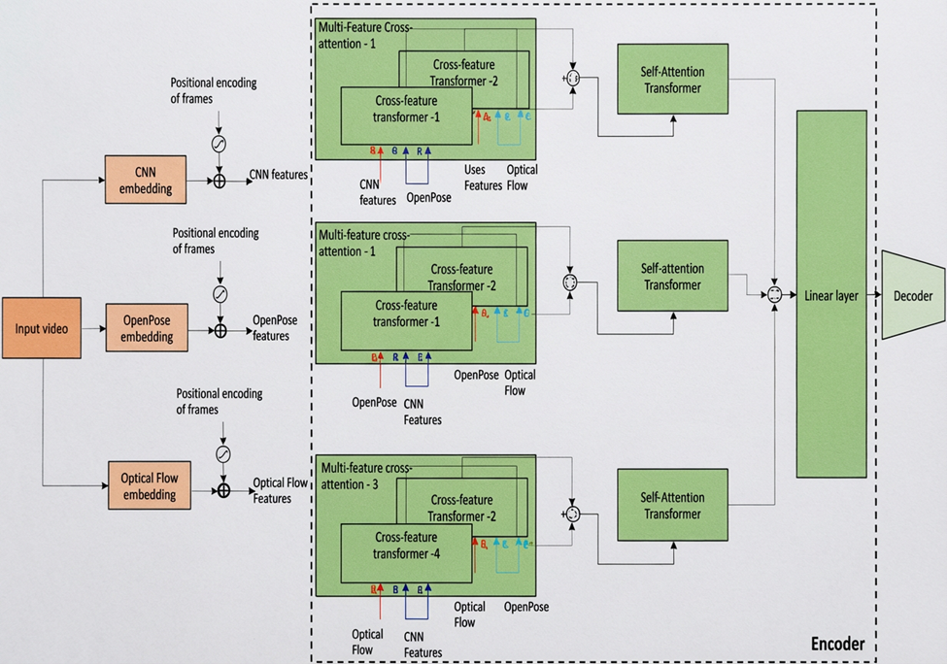
SYSTEM ARCHITECTURE
Transformer-based multi-stream encoder-decoder architecture
Eluru College of Engineering & Technology | Dept. of CSE | 2026

Slide 11
UML DIAGRAMS
Class • Use Case • Collaborative

Slide 12
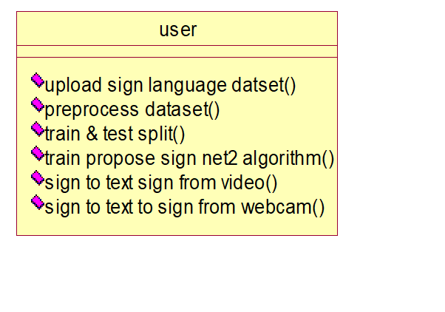
CLASS DIAGRAM: Sign-to-Text
Object-oriented design of the translation system
Class Responsibilities
upload sign language dataset()
Loads raw sign language video data into the pipeline
preprocess dataset()
Normalizes frames, extracts keypoints and optical flow
train & test split()
Divides data into training and validation sets
train propose sign net2 algorithm()
Trains the SignNet-II Transformer model
sign to text from video()
Converts uploaded sign video to text output
sign to text from webcam()
Real-time webcam-based sign recognition
Eluru College of Engineering & Technology | Dept. of CSE | 2026

Slide 13
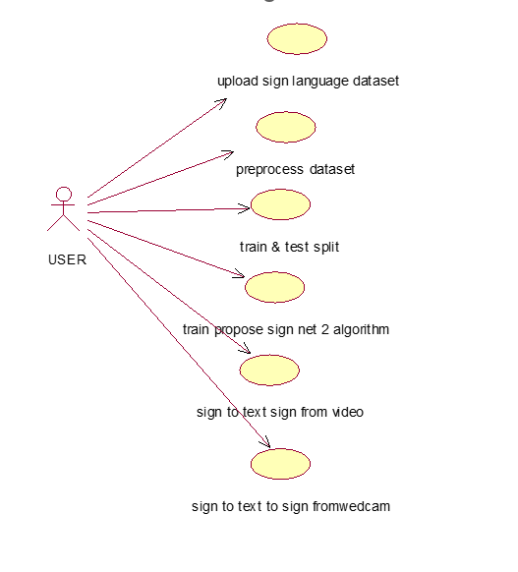
USE CASE DIAGRAM: Sign-to-Text
User interactions for sign recognition module
Use Case Summary
Upload sign language dataset
Load and preprocess video frames
Train & test data split
Train SignNet-II algorithm
Sign to text from uploaded video
Sign to text via live webcam
Eluru College of Engineering & Technology | Dept. of CSE | 2026

Slide 14
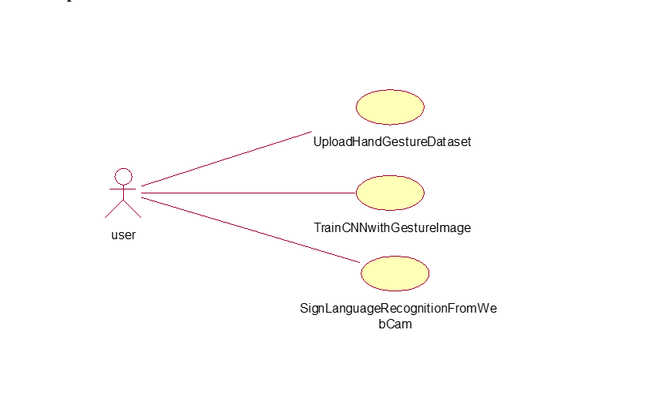
USE CASE DIAGRAM: Text-to-Sign
User interactions for sign generation module
Text-to-Sign Use Cases
Home page access
User registration (Sign-Up)
User login authentication
Enter text input
Submit and view sign animation
Result display with sign video
Eluru College of Engineering & Technology | Dept. of CSE | 2026

Slide 15
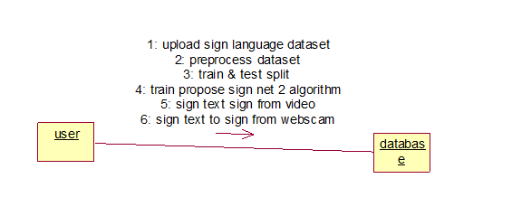
COLLABORATIVE DIAGRAM
Sequence of interactions between system components
Eluru College of Engineering & Technology | Dept. of CSE | 2026

Slide 16
WORKING OF THE INTERFACE
Sign-to-Text Module — Step by Step

Slide 17
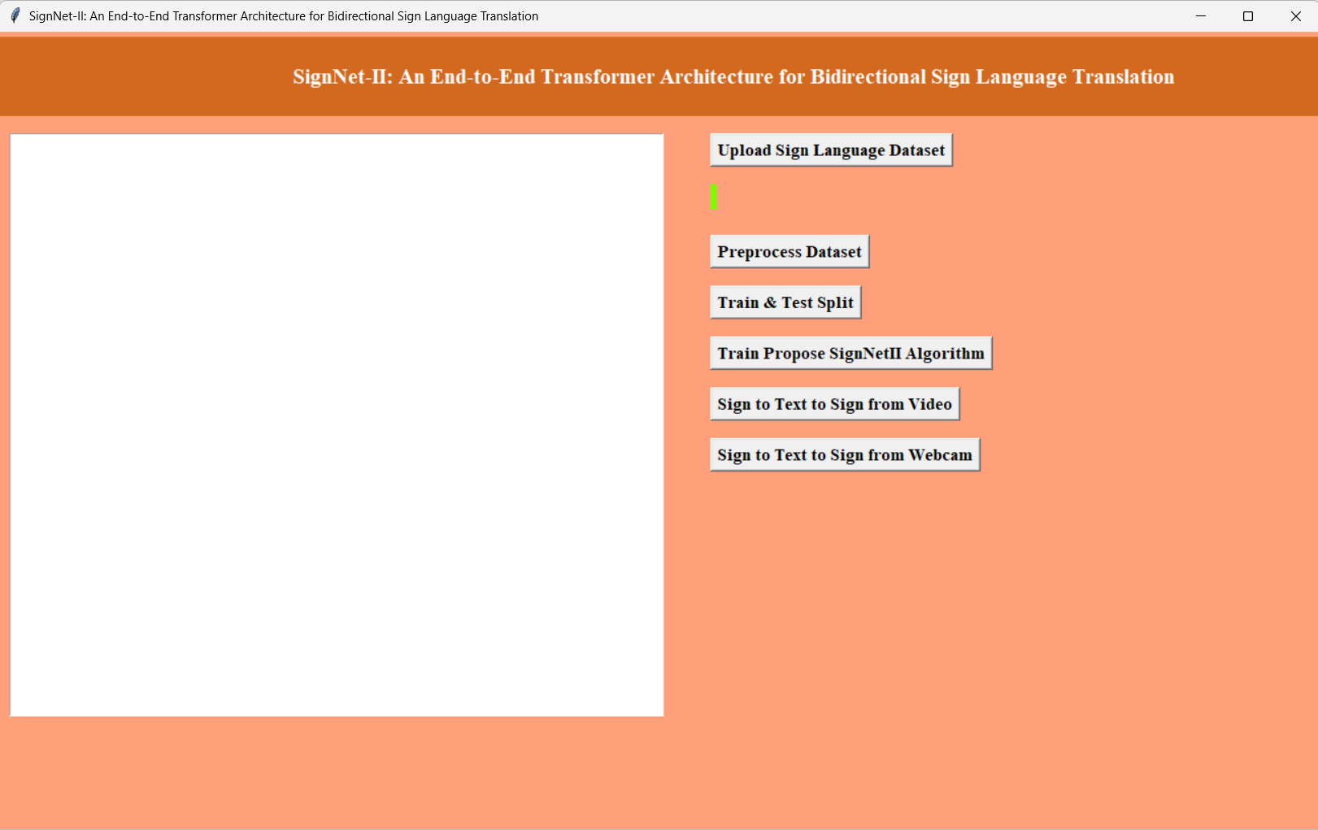
Step 1: Load the Application
Sign-to-Text Interface
1/8
Description
Launch the SignNet-II application. The main interface loads with navigation options for Sign-to-Text and Text-to-Sign modules.
Eluru College of Engineering & Technology | Dept. of CSE | 2026

Slide 18
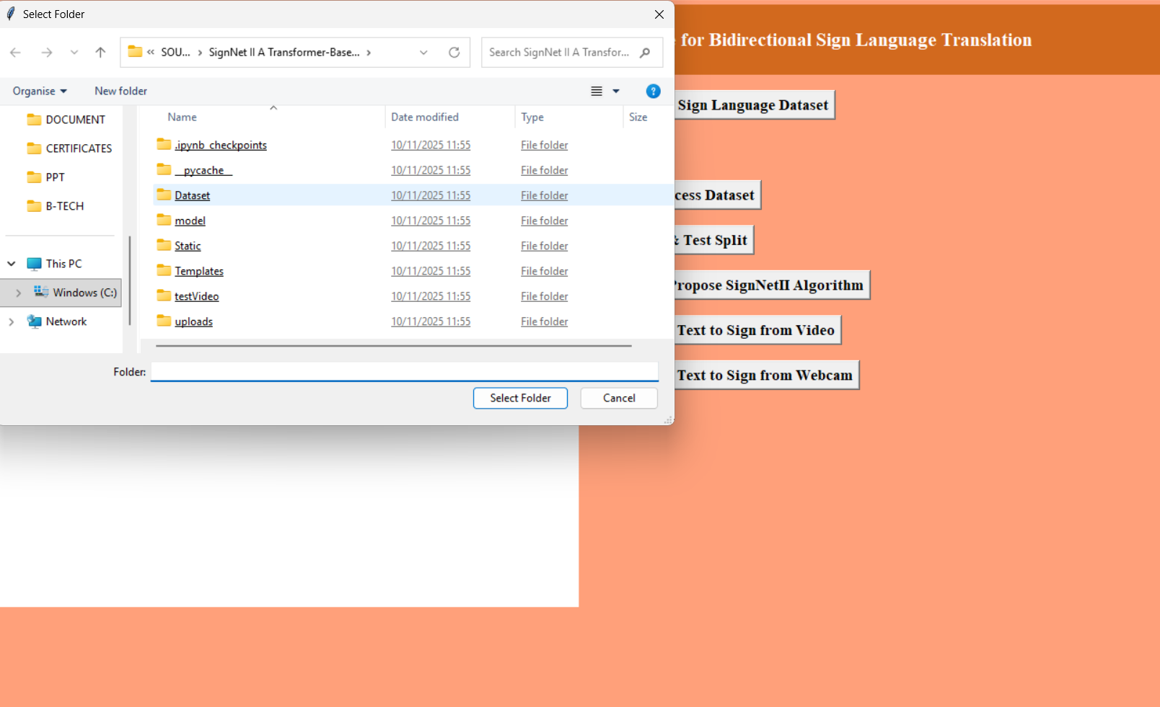
Step 2: Load the Dataset
Sign-to-Text Interface
2/8
Description
Upload the sign language dataset. The system accepts video files containing continuous signing sequences for training and testing.
Eluru College of Engineering & Technology | Dept. of CSE | 2026

Slide 19
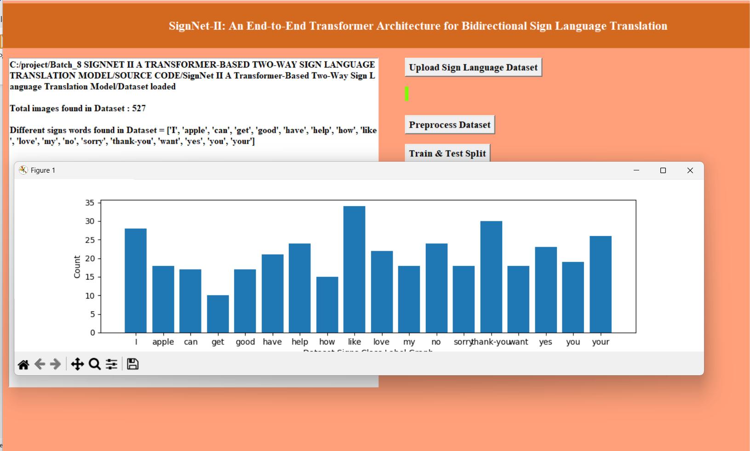
Step 3: Process the Dataset
Sign-to-Text Interface
3/8
Description
The preprocessing pipeline extracts video frames, applies OpenPose for keypoint detection, and computes optical flow features.
Eluru College of Engineering & Technology | Dept. of CSE | 2026

Slide 20
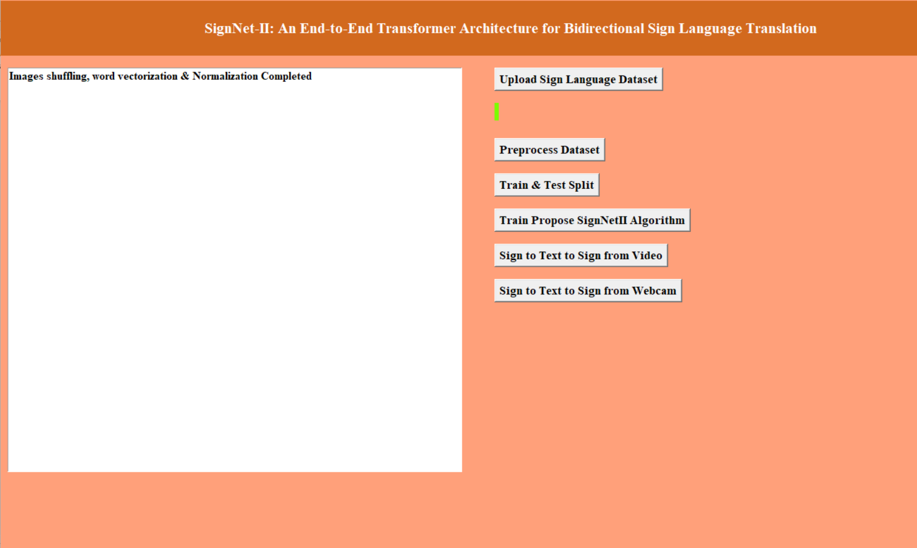
Step 4: Train & Test Data Split
Sign-to-Text Interface
4/8
Description
The dataset is split into training and testing subsets. Stratified sampling ensures balanced class representation across splits.
Eluru College of Engineering & Technology | Dept. of CSE | 2026

Slide 21
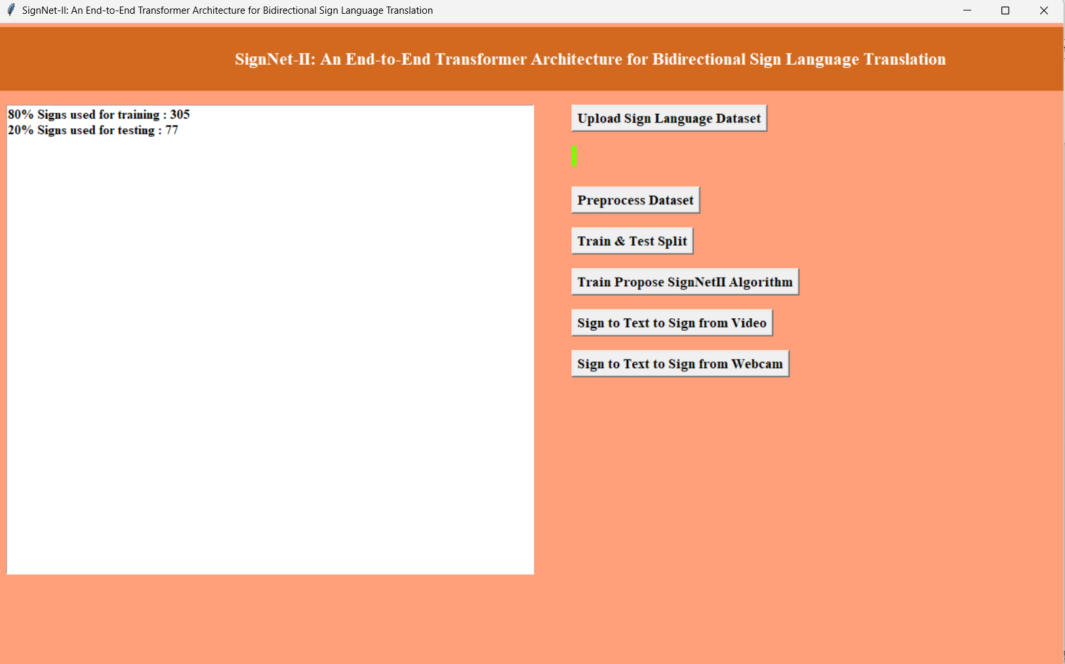
Step 5: Train SignNet-II Algorithm
Sign-to-Text Interface
5/8
Description
The Transformer-based SignNet-II model is trained on the prepared dataset. Training progress, loss curves, and metrics are displayed.
Eluru College of Engineering & Technology | Dept. of CSE | 2026

Slide 22
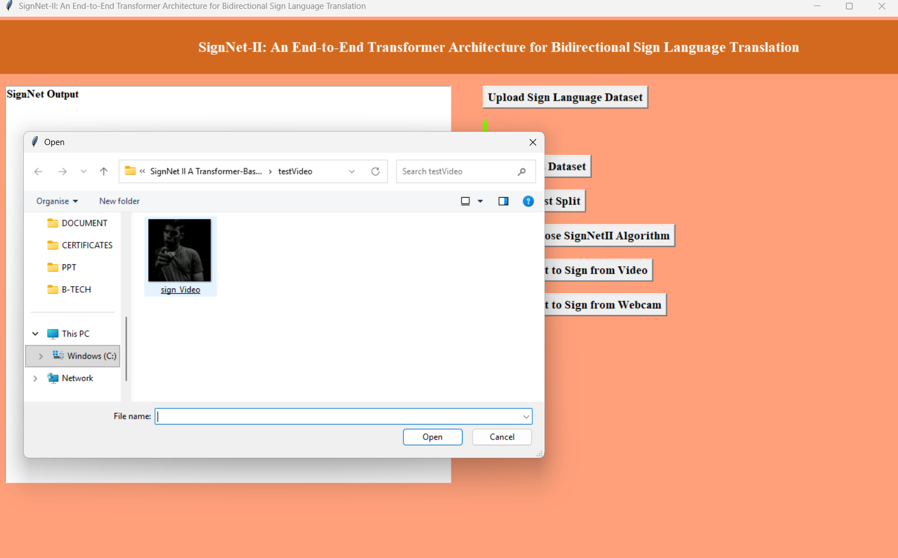
Step 6: Upload Video for Recognition
Sign-to-Text Interface
6/8
Description
Upload a sign language video file for translation. The system accepts MP4/AVI formats and processes the video through the trained model.
Eluru College of Engineering & Technology | Dept. of CSE | 2026

Slide 23
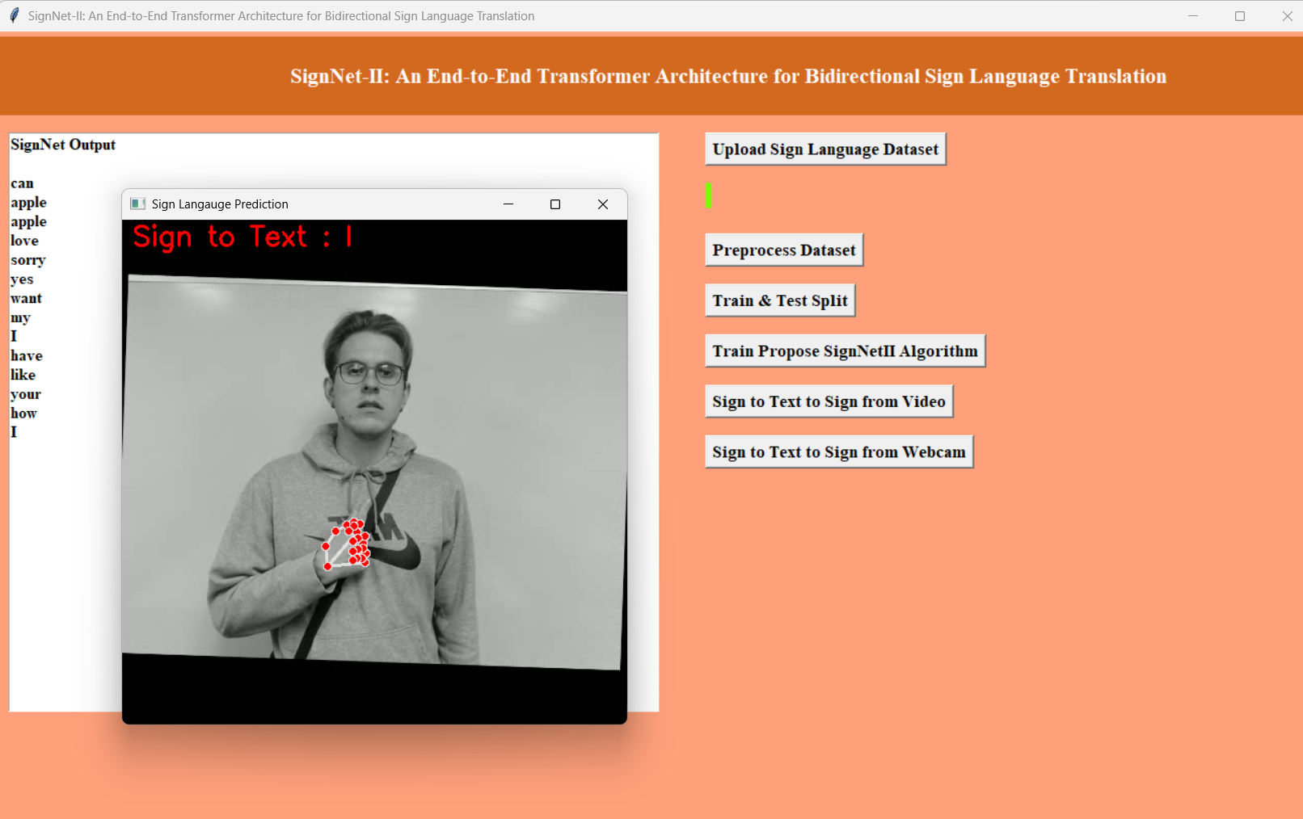
Step 7: Sign to Text — From Video
Sign-to-Text Interface
7/8
Description
The model processes the uploaded video and outputs the recognized text translation with confidence scores for each predicted token.
Eluru College of Engineering & Technology | Dept. of CSE | 2026

Slide 24
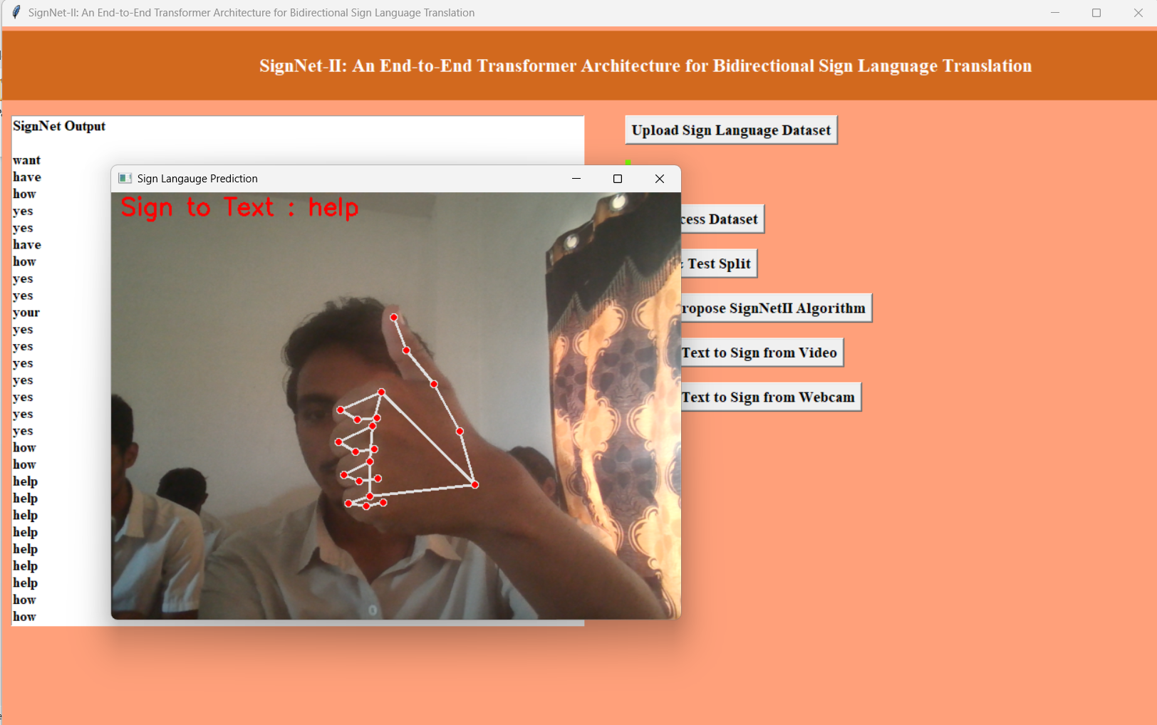
Step 8: Sign to Text — From Webcam
Sign-to-Text Interface
8/8
Description
Real-time sign-to-text translation using live webcam feed. The system processes frames continuously and displays translations in real time.
Eluru College of Engineering & Technology | Dept. of CSE | 2026

Slide 25
WORKING OF THE INTERFACE
Text-to-Sign Module — Step by Step

Slide 26
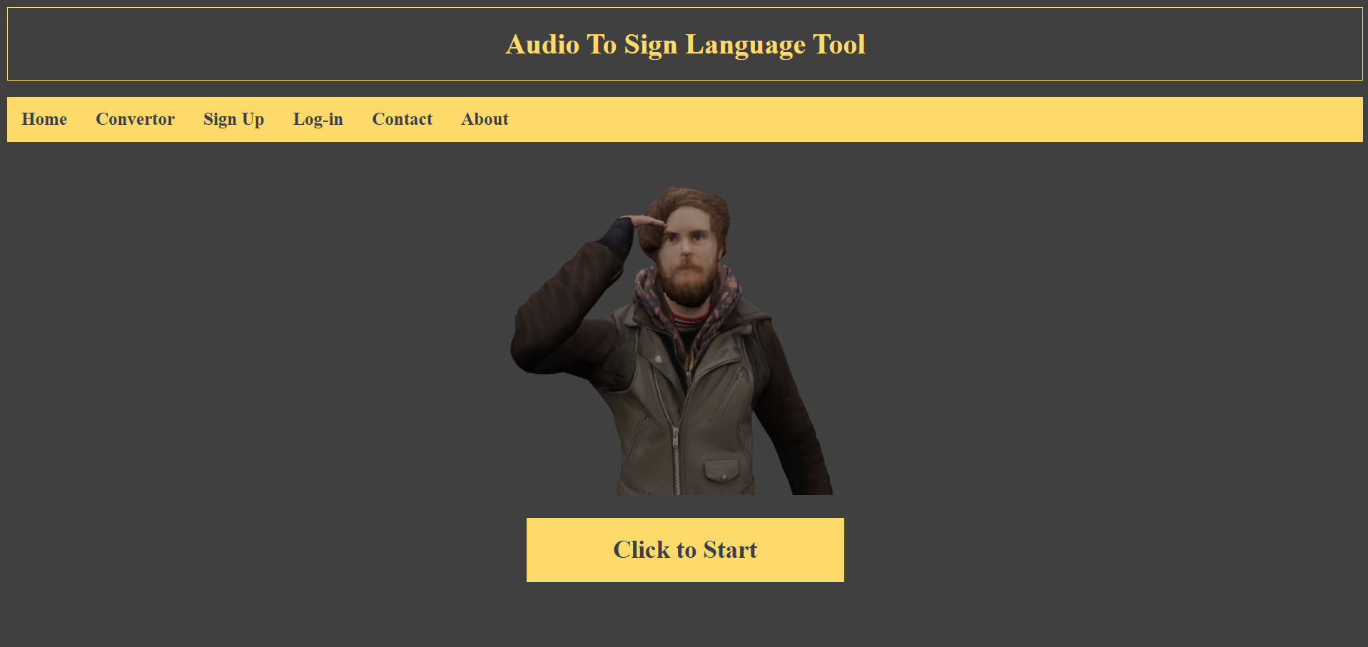
Step 1: Home Page
Text-to-Sign Interface
1/5
Description
The Audio-to-Sign Language Tool home page. Users see the main interface with a start button to begin the text-to-sign translation workflow.
Eluru College of Engineering & Technology | Dept. of CSE | 2026

Slide 27
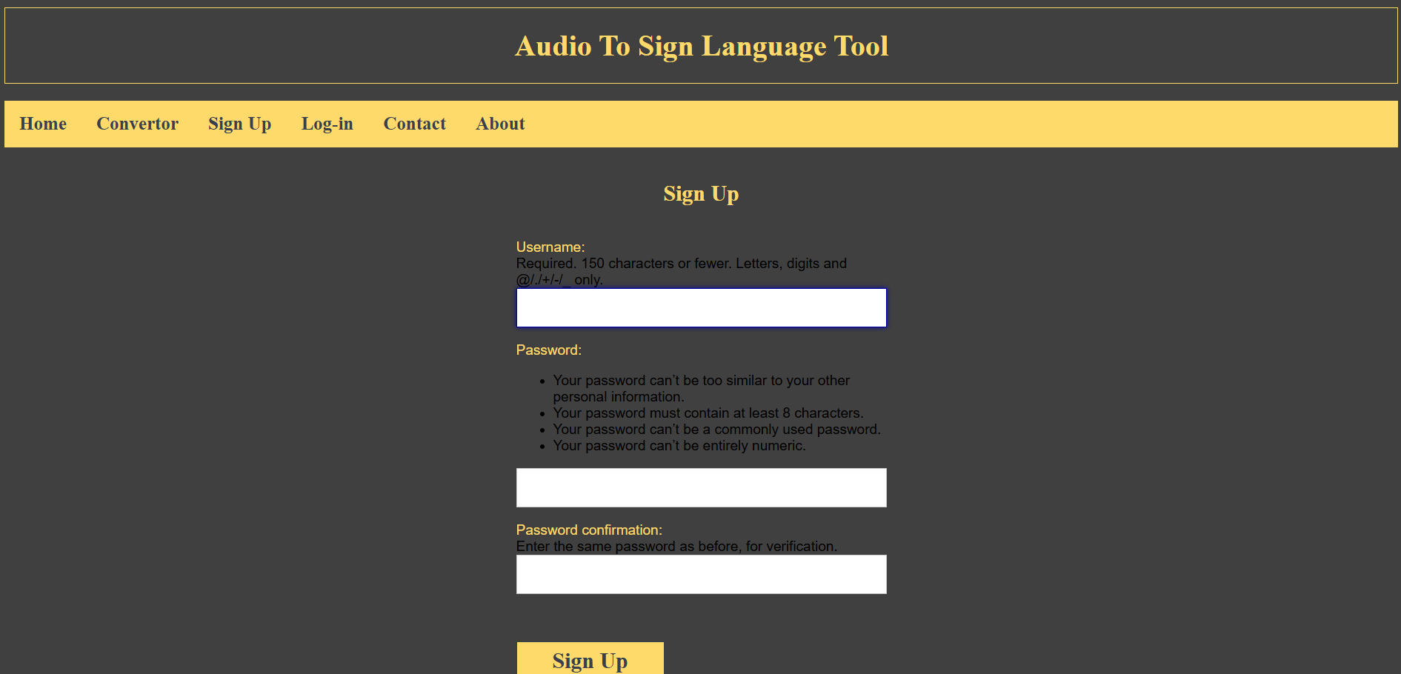
Step 2: Sign-Up / Registration
Text-to-Sign Interface
2/5
Description
New users register with their credentials. The system creates a secure account enabling personalized access to the translation service.
Eluru College of Engineering & Technology | Dept. of CSE | 2024

Slide 28
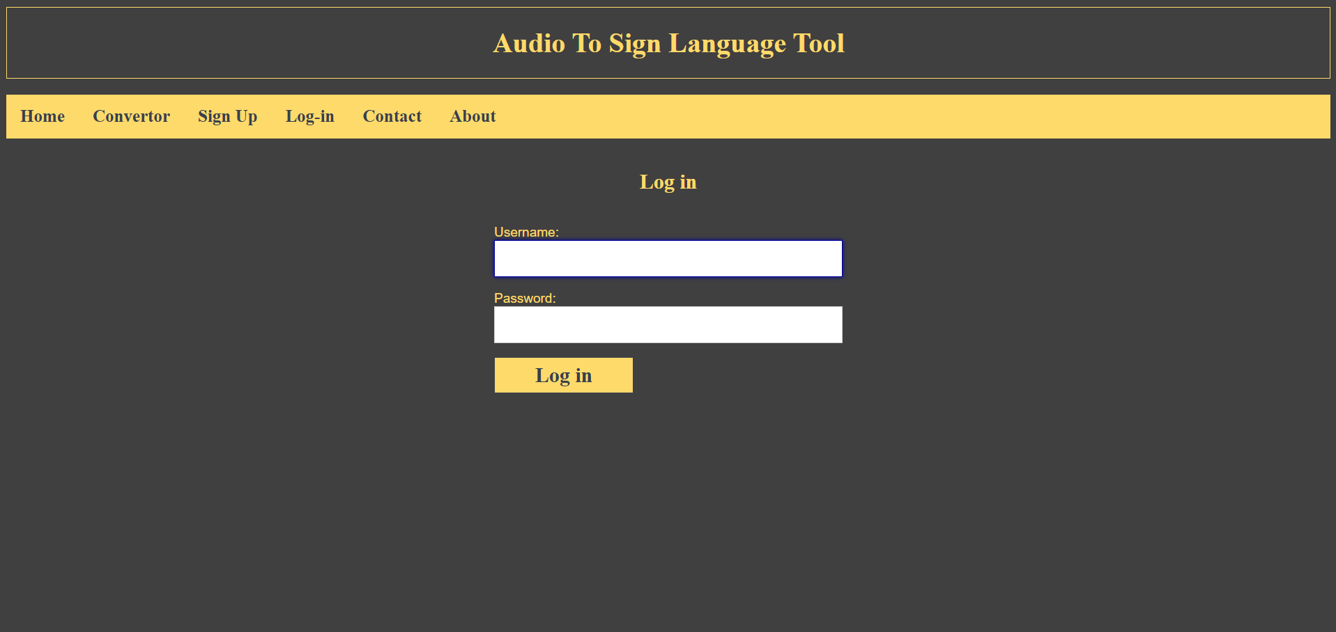
Step 3: Log-In
Text-to-Sign Interface
3/5
Description
Registered users authenticate with their credentials. The system validates the login and grants access to the full translation dashboard.
Eluru College of Engineering & Technology | Dept. of CSE | 2026

Slide 29
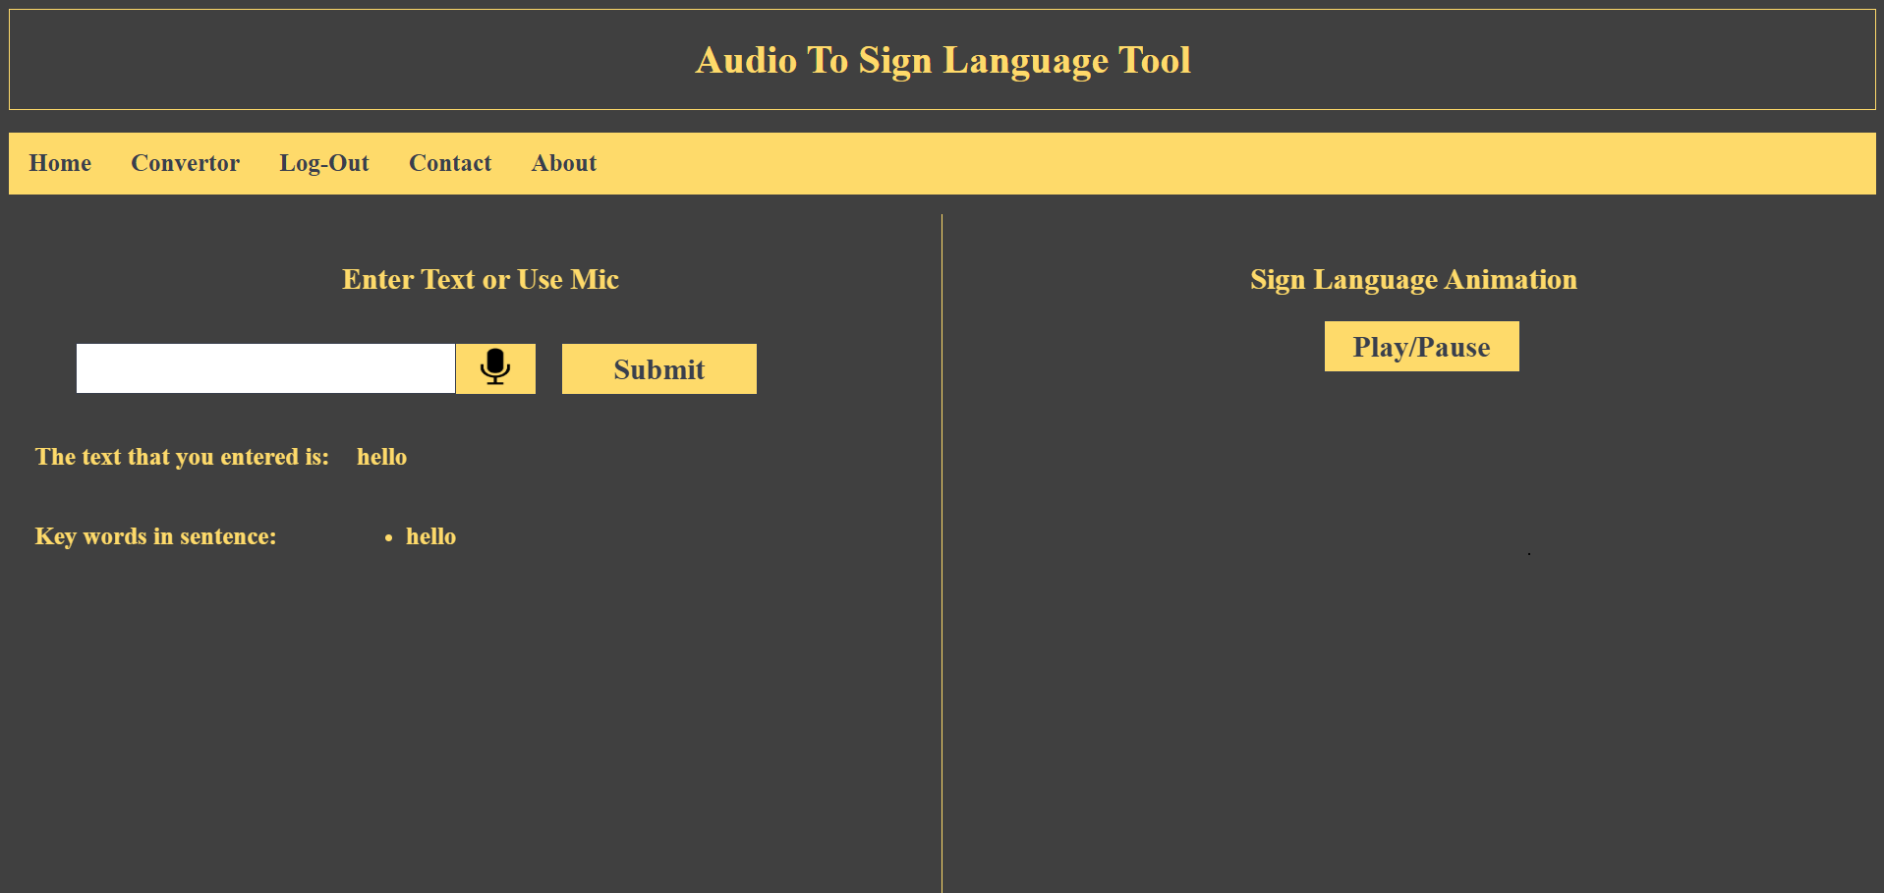
Step 4: Enter Text and Submit
Text-to-Sign Interface
4/5
Description
Users type any text into the input field and click Submit. The NLP module tokenizes and prepares the text for sign animation generation.
Eluru College of Engineering & Technology | Dept. of CSE | 2026

Slide 30
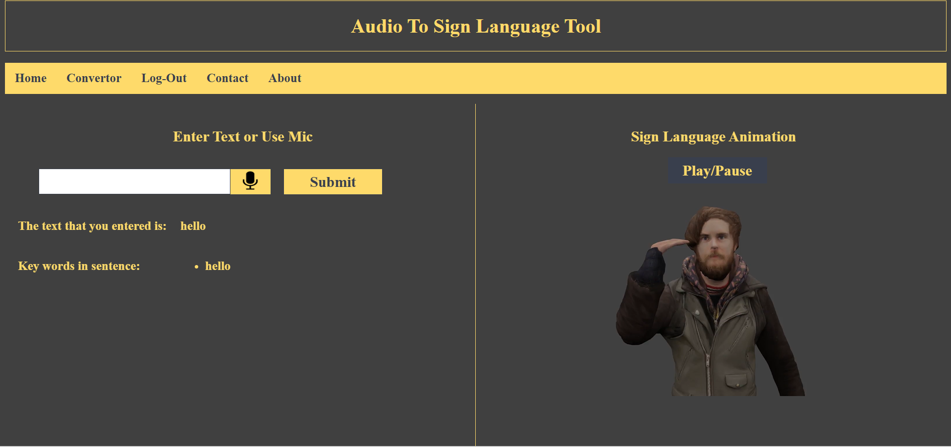
Step 5: Result — Sign Animation
Text-to-Sign Interface
5/5
Description
The system generates and plays a sign language animation corresponding to the entered text, displayed alongside the input for reference.
Eluru College of Engineering & Technology | Dept. of CSE | 2026

Slide 31
CONCLUSION
Summary and impact of SignNet-II
Sign language is one of the most vital tools for communication between the deaf and mute communities and the broader society.
Bridging Communication Gaps
Technical Achievement
SignNet-II provides a scalable solution for real-time communication between deaf/mute individuals and non-signers without requiring prior knowledge of sign language.
The Transformer-based architecture delivers state-of-the-art BLEU scores, outperforming traditional RNN/LSTM methods in both accuracy and inference speed.
Bidirectional Translation
Future Scope
The unified framework enables both sign-to-text and text-to-sign translation, making it far more versatile than any existing single-direction system.
Future work includes mobile deployment, multi-language support, federated learning for privacy-preserving training, and integration with AR/VR assistive devices.
Eluru College of Engineering & Technology | Dept. of CSE | 2026

Slide 32
REFERENCES
Academic and research sources
Amit kumar shinde and Ramesh Khagalkar
1
Sign language to text and vice versa recoganization using computer vision in Marathi. International Journal of Computer Application (0975-8887), National Conference on Advanced Computing (NCAC 2015).
Sulabha M Naik, Mahendra S Naik, Akriti Sharma
2
Rehabilitation of hearing impaired children in India. International Journal of Advanced Research in Computer and Communication Engineering.
Neha Poddar, Shrushti Rao, Shruti Sawant, Vrushali Somavanshi, Prof. Sumita Chandak
3
Study of Sign Language Translation using Gesture Recognition. International Journal of Advanced Research in Computer and Communication Engineering, Vol. 4, Issue 2, February 2015.
Eluru College of Engineering & Technology | Dept. of CSE | 2026

Slide 33
THANK YOU
SignNet-II: An End-to-End Transformer Architecture for Bidirectional Sign Language Translation
Eluru College of Engineering & Technology | Department of Computer Science and Engineering | 2026

